Slide 1
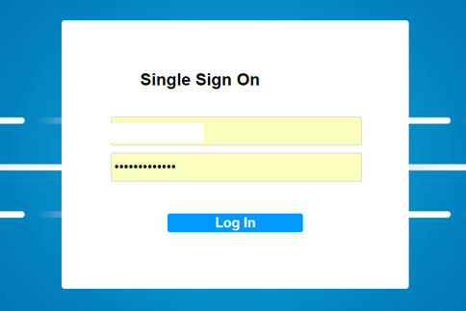
CoCoTech
Sign on
Table with
Fake SSO
And PW
JSON LOGON
– Voice Greeting at the welcome page here
“Welcome to CoCoTech, easy ticket generation portal for your problem”

Slide 2
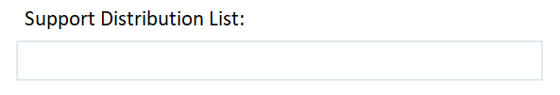

CoCoTech – Support Search
Search
<DIV> for display search results
-DL 1 (user clicks this DL, it will go to the ticket logon page
List of
DL name
Here in the table
How do we make DL1
As an active button so
It will take to another page
For Ticket creation

Slide 3


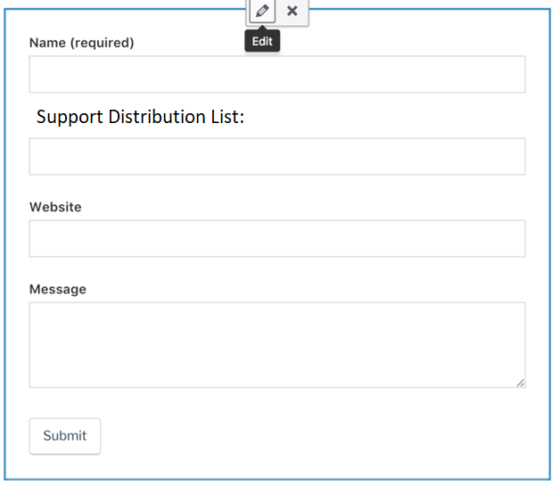
Logon (to open a ticket)
Table:
Name
SSO
Nature of issue
Site Name
…….
Auto generate Ticket#
Then post the results
To email
15
<DIV> for display search results
Technicians
12 documents
KB:
DDI For more details:
http://DDIkb.cocotech.com
OPEN A TICKET CLICK HERE
Then logon page pop up on the right
When clicking submit button, it generates Ticket#
Ticket Number created:
# 123123123

Slide 4
CocoTech- Technicians
8
Active
WorkerNumber | DisplayName
717111177 | Doe, Mark (ST Digital)
777671368 | Fer, Robert (ST Digital)
773177777 | Key, Sai (ST Digital)
711173746 | Mc, Alan (ST Digital)
711176671 | Mont, Bill (ST Digital)
777737737 | Mur, David (ST Digital)
717777698 | Pi, Patrick (ST Digital)
777611797 | Sim, Nu (ST Digital)
717374378 | Beg, Ashma (ST Digital)
713178787 | Cha, Eresh (ST Digital)
713197717 | Das, So (ST Digital)
713169777 | Huss, Wa (ST Digital)
717698791 | Ku, Anil (ST Digital)
713178777 | R, Giri (ST Digital)
713713918 | R, Kart(ST Digital)
713147836 | Ram, Ha (ST Digital)
713717377 | Rao, Na (ST Digital)
713717379 | V, Ni (ST Digital)
717347364 | Var, Bi (ST Digital)
717777336 | Vin, Ka (ST Digital)
717777839 | Hock, Ches (ST Digital)
717786666 | Arms, Dany(ST Digital)
717847387 | Bary, Scott (ST Digital)
713134887 | Dec, Brian (ST Digital)
717979763 | Mar, Amy (ST Digital)
717773719 | Srin, Kart (ST Digital)
Chat BOT HERE
Make 5 technicians green
And chat bot will be able to chat
With one of them when user clicks on
The GREEN NAME

Slide 5
CocoTech
Control | Type | Document Name | URL
Vulnerbility | SOP | SaiTech SOP on Patching Management | http://saitech.com/doc1
Operations | SOP | SaiTech SOP on Server Build | http://saitech.com/doc2
Asset Life Cycle | WI | SaiTech WI on Asset Management | http://saitech.com/doc3

